Slide 2
The future of the past: CLAROS
Donna Kurtz, Beazley Archivist and Professor of Classical Art, Faculty of Classics
28 August, 2009
Berlin
Notes:
2
Thank you for inviting us. I have had long and close working relations with Berlin and am honoured to be giving a concluding lecture to your conference. The advertised title, the Second Life of Classical Antiquity, was created almost two years ago. Technology has changed, and so has my title: the future of the past seems more appropriate for FIEC.
I am not a mainstream classicist, and my lecture may not be what you are expecting. I was trained in Greek and Latin languages and literature, in the history of Greece and Rome, and in archaeology from Bronze Age Greece through the Roman Empire, but I am an art historian and one who became fascinated by the history of scholarship – and by computers. This unusual combination of interests has been able to flourish in Oxford where a post was created for me many years ago to look after Sir John Beazley’s archive. What he would make of his presence in cyberspace I cannot being to imagine, but I think Beazley would approve of my commitment to the scholarship of classical antiquity. It is a wonderfully rich subject – language and literature, history and philosophy, archaeology and art, all intellectually coherent and complementary. Bringing these parts of our subject together benefits everyone. Technology offers opportunities to do this, to advance scholarship and also disseminate it broadly as never before, and this gives us a very bright future.

Slide 3
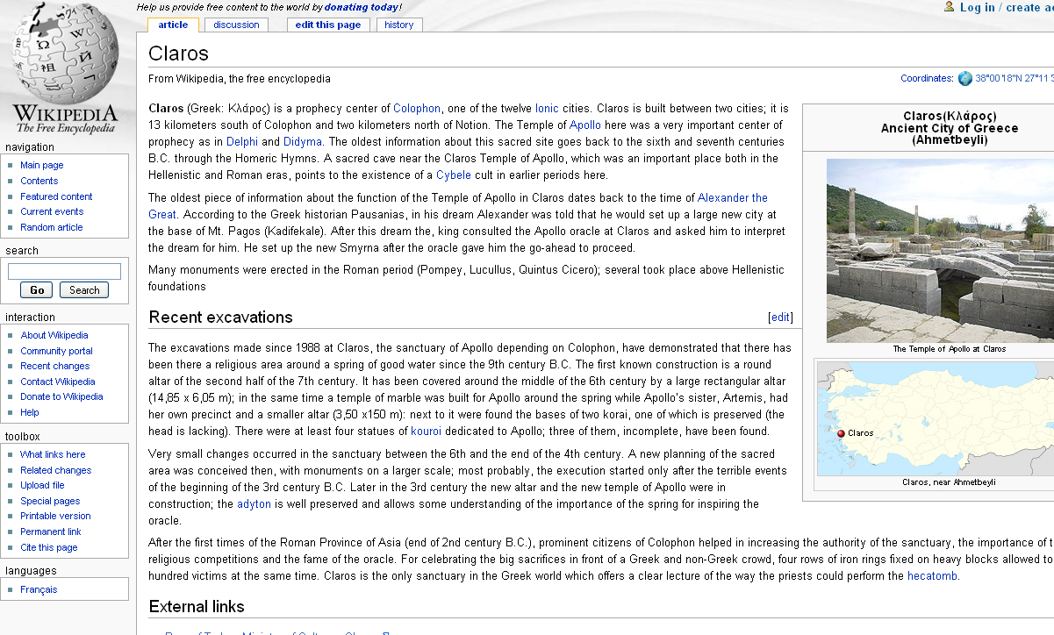
What is CLAROS?
Notes:
What is CLAROS and why is it worthy of FIEC’s consideration?
Let’s begin with the name.
When many of us find an unfamiliar term we go to the web. Wikipedia tells us that CLAROS is an ancient Greek archaeological site on the western coast of modern Turkey - an area settled by Greeks from the 2nd millennium BC. In classical times the Greek city of Claros had a famous oracle.
We might like to think that the prophetic powers of Claros bode well for our ground-breaking ICT project!
3

Slide 4
Classical Art Research Online Services
Collaborative research initiative led by the University of Oxford
Two areas of multi-disciplinary research
Classical antiquity
Information and Communication Technologies
Two aims
Enhance and disseminate the highest level of scholarship to the broadest global public
Use datasets in Classics and Classical Art to exploit the potential of ICT for public service
Notes:
In fact, the ancient site and its oracle had nothing to do with our choice of the name.
We needed an acronym for Classical Art Research Online Services – to complement a name we had already chosen for the Beazley Archive in 2007 when it was moved into the new home for the Faculty of Classics and became the University of Oxford’s Classical Art Research Centre.
4

Slide 5
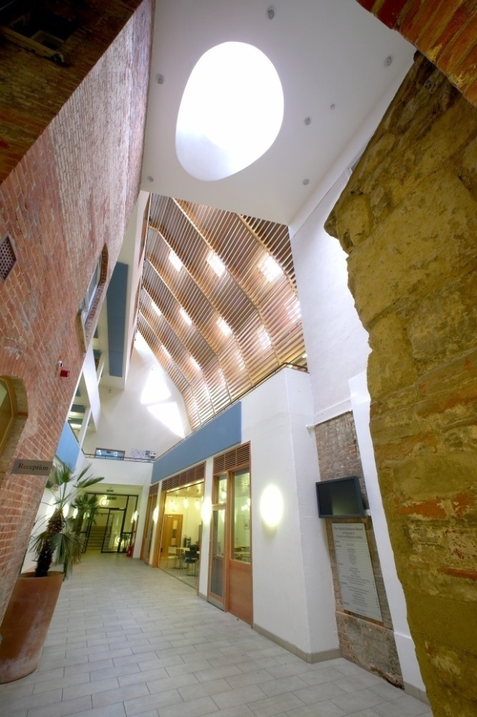
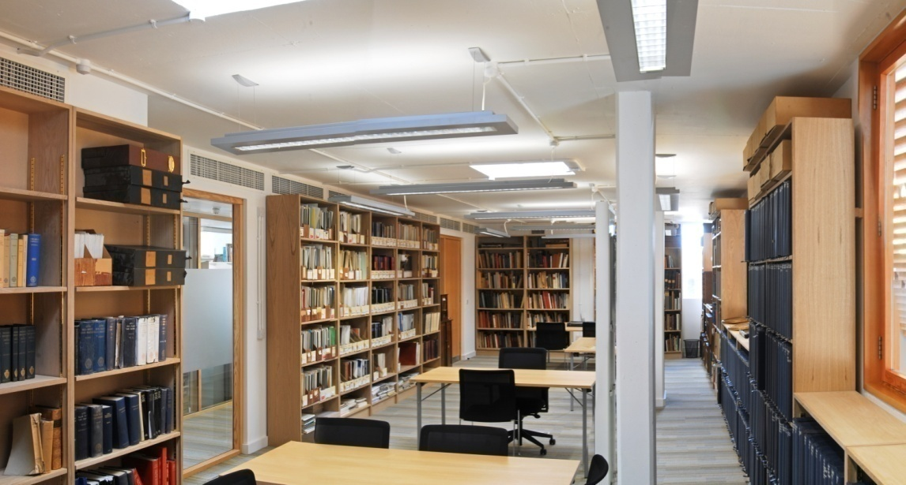
Ioannou School of Classical and Byzantine Studies, opened in spring 2007
The Beazley Archive Library
Atrium of the School
Notes:
This international multi-disciplinary initiative is led by the Beazley Archive, from its new home, in the Ioannou School, adjacent to its old home in the Ashmolean Museum.
Two 19th century houses in the foreground, where you see the brickwork, were joined to a new building in the background. The Archive is on the top floor.
5

Slide 6
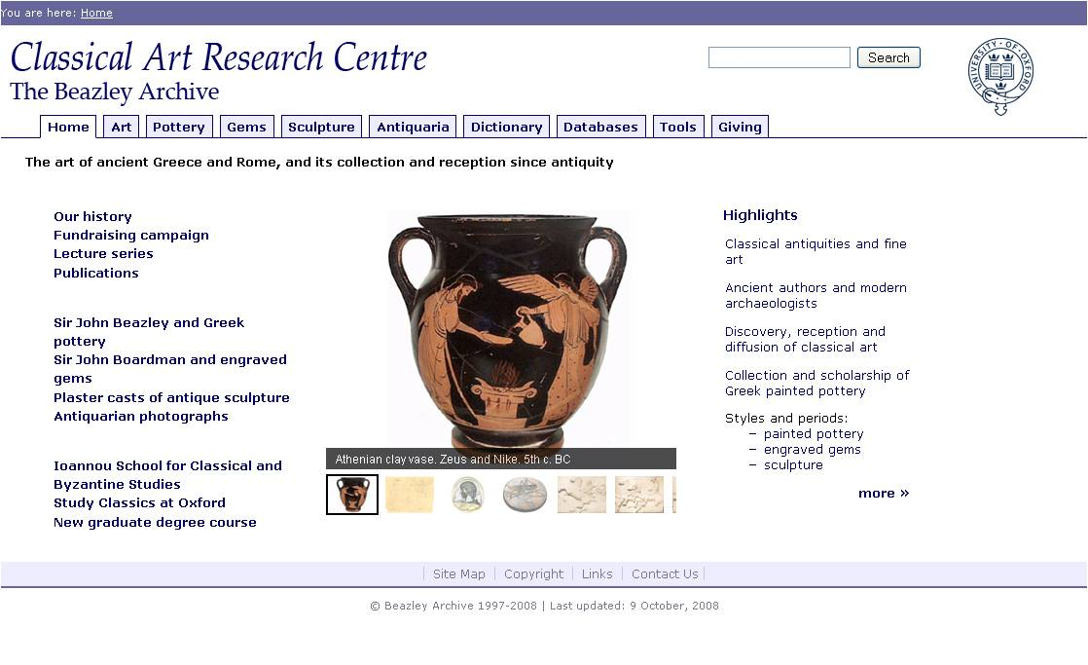
Notes:
The Beazley web site is the model for CLAROS because it serves a broad range of users, from the senior scholar to the school child, from the museum curator and visitor to the public at home. Like Beazley CLAROS is committed to advancing scholarship about classical antiquity and disseminating it widely.
The Dictionary and Tools, in the horizontal navigation bar, aid the non specialist, as do subject tabs. The search box, above the navigation bar, finds any type of information on the site. The serious scholar can go directly to the databases; the novice can browse.
Our commitment to public service is explained by the Archive playing a key role in undergraduate and graduate teaching and research, and to it being in the basement of the Ashmolean Museum for nearly 40 years. User ‘feedback’ has never been far away!
6

Slide 7
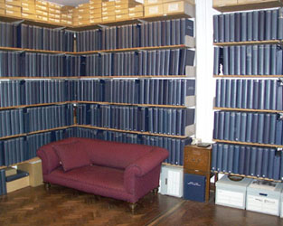
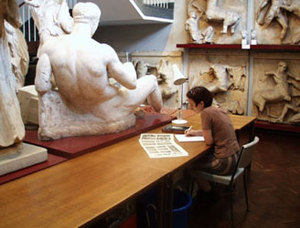
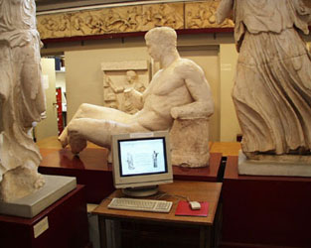
Ashmolean Museum, Cast Gallery basement
Notes:
We carried out our work among the plaster casts and visitors to the museum. We could ask them what they thought about the web site which was available in the gallery.
7

Slide 8
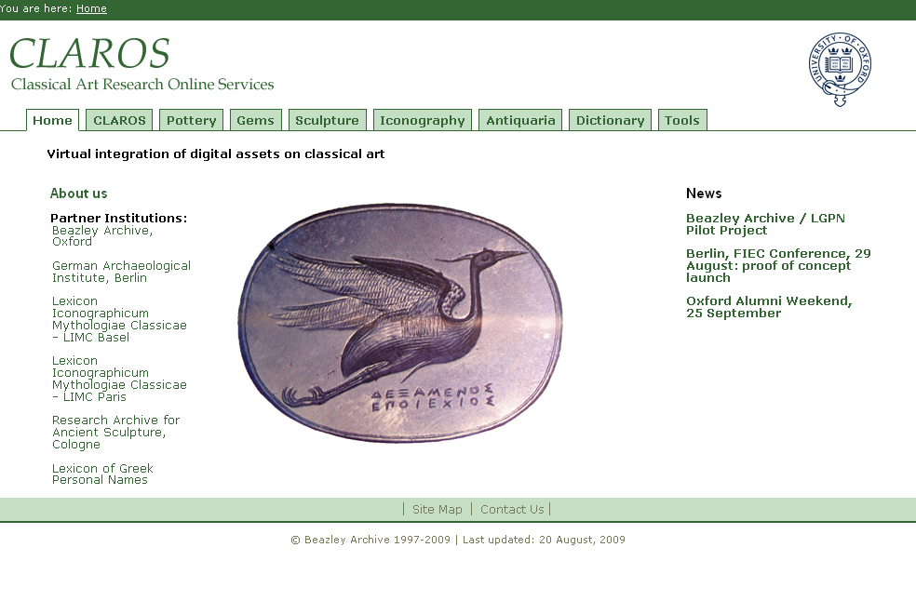
Notes:
By transferring this broad-public access model to CLAROS all of our colleagues listed on the left side of the Home Page can deliver their data to many different types of users from the launch of the system.
You will notice that one, the Lexicon of Greek Personal Names, is not an art resource.
The Lexicon records names that can appear in literature, documents and on art objects. Academically the Lexicon enables CLAROS academically to begin to unite classical art with its literate societies, and technically to build bridges to the large and well-developed digital worlds of literature and documents. This is a holistic approach to classical antiquity.
We started with objects because that is what the Archive studies. We invited partners to work with us who had large and well developed digital assets. We had worked with them for many years; we respected and trusted each other, and we shared the vision of bringing our data together. As this audience will know, they are the world class research centres.
We are not an ‘exclusive club’; we are a foundation on which to build, to welcome others and to transfer our accrued knowledge and expertise for their benefit.
We will welcome others and we will transfer our accrued knowledge for their benefit.
8

Slide 9
Our presentation today
Vision and reality
Donna Kurtz, Beazley Archive, Faculty of Classics
Data
Greg Parker, Technical Director, Beazley Archive
Datawebs
Graham Klyne, Image Bioinformatics Research Group, Zoology
Image recognition
Andrew Zisserman, Computer Vision, Engineering Science
Artificial intelligence
Yorick Wilks, Oxford Internet Institute
Notes:
When this presentation is given in Oxford next month four technical experts will speak. Today, thanks to the support of the DAI, our dataweb developer, Graham Klyne, is here with me to provide an overview of the technical work being carried out by Greg Parker, Andrew Zisserman and Yorick Wilks.
Reinhard Foertsch and Robert Kummer will join him to speak about Cologne’s very significant contribution to CLAROS.
As project director I will speak briefly about CLAROS’ content and purpose.
9

Slide 10
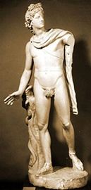
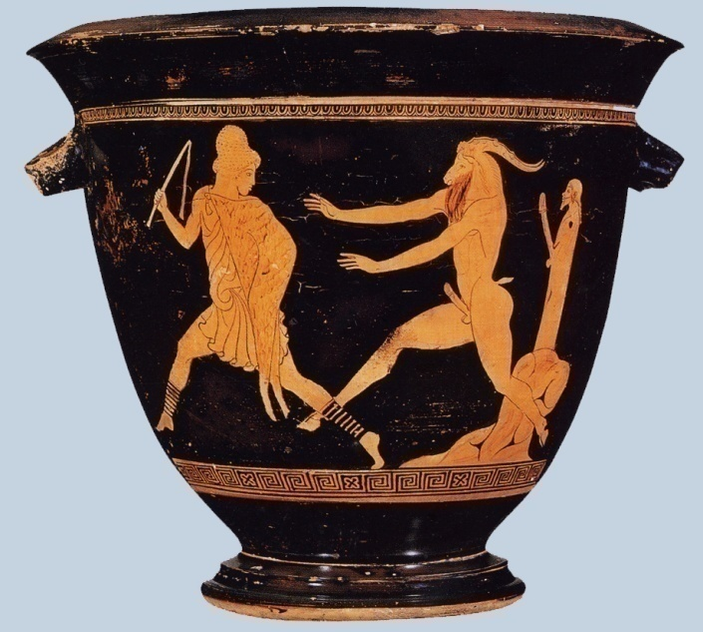
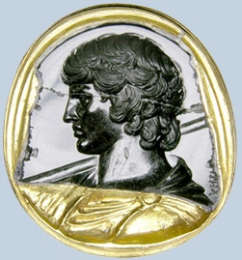
Classical art
The art of the ancient Greeks and Romans
Pottery Gems Sculpture
Notes:
The art of ancient Greece and Rome is well known to this audience – sculpture, architecture, painting, pottery and gems, bronzes and terracottas – an art known, collected and exhibited in the great museums of the world.
The Beazley Archive and its art colleagues in CLAROS document these objects. Over thirty years we have created catalogues of museum holdings with the type of scholarly documentation that very few can afford to carry out on their own. We can do it because we are research centres in major universities.
10

Slide 11
Notes:
We would now like to show you CLAROS. Attempting to do this live, in the Foreign Office on a Saturday in the summer, is tempting fate.
To save time and, we hope, to guarantee success, we will show you screencasts – a series of screens that Greg Parker has linked to form a seamless presentation.
After the screencasts Graham, Reinhard and Robert will talk about the technology behind CLAROS.
11

Slide 12
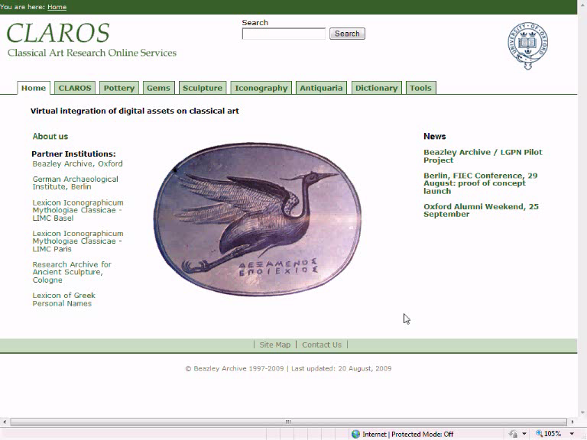

Slide 13
Data
University of Oxford – Beazley Archive
Electronic documentation started 1979
150,000 Pottery records and 130,000 images
50,000 Engraved gem and cameo records and 30,000 images
900 Plaster casts records (classical sculpture) and 1000 images
900 Antiquarian photographs
University of Oxford - Lexicon of Greek Personal Names
Electronic documentation started 1975.
400,000 recorded individuals. Over 35,000 unique personal names.
University of Cologne – Research Sculpture Archive
Electronic documentation started 1972
250,000 Sculpture records, 490,000 images.
Notes:
Greg Parker, the Archive’s director of IT was able to create the CLAROS Explorer because he has been working with these datasets for many years. He understand the subject.
In the screencasts records and images were coming from five content providers in different parts of Europe. Three are listed here [allow 5 seconds for audience to read screen]
13

Slide 14
Data
German Archaeological Institute
1,500,000 photographs
University of Paris X - Lexicon Iconographicum Mythologiae Classicae
Created 1972.
100,000 records, 180,000 images of mythological and religious iconography from 2,000 museums and collections.
Total
2 million records and images
Notes:
And two more here.
Together we have more than 2,000,000 records and images.
When we complete the mapping of LIMC datasets in Basle, Athens, Heidelberg, Wurzburg and elsewhere there will be many more than 2 milllion. This is a foundation for future development.
14

Slide 15
Databases
Beazley Archive: ‘XDB’ – XML data, SQL Server Database, ASP front end.
Cologne Research Archive and German Archaeological Institute: ‘Arachne’ - MySQL database, PHP front end.
LIMC: MySQL database, PHP front end.
LGPN: Ingres relational database, also available as an eXist XML database serving TEI-XML data. XQuery front end.
Notes:
Each partner has developed his own database system over decades.
15

Slide 16
Databases
The variety of databases demonstrates how other partners can join with relatively little effort.
No changes required to existing databases or programs.
Interchange of data is achieved by export of underlying data to CIDOC-CRM.
Notes:
In CLAROS each needs to make no change to his content, the format of his database, or to his web site.
Each also retains his data and his IPR.
CLAROS facilitates exchange of information; it imposes no restrictions on data providers.
For the technology behind CLAROS I hand you over to Graham Klyne, the dataweb developer.
16

Slide 17
CLAROS System Components
Beazley Archive
DAI Arachne
LIMC (Paris)
LGPN (Oxford)
Convert
Convert
Convert
Convert
CIDOC-CRM data
Cache
Links back to original data
Index
Query
Other potential applications
CLAROS application
Browser
Notes:
17
The CLAROS system provides what we might call a search and discovery service over the different data sources.
They have each developed independently over many years and each uses different underlying technologies to deliver information about the same very large subject.
Each also uses different technologies and different vocabularies to represent information.
CLAROS needed a way to bring them together. Instead of developing our own bespoke system we looked very carefully at the work that had already been done and we found two standards that seemed to suit our needs.
The first is CIDOC-CRM. This is an ISO standard that was developed under the aegis of UNESCO for ICOM – for the world’s museums.
It provides a flexible framework and vocabulary, and seems to offer greater potential for creating a common framework than other systems we know such as OAI, CDWA and MuseumDat.
It also seems to be well suited to other domains, such as describing scientific experiments – the type of work that I usually do with computers. And this seems to us to be a good thing.
The second is RDF. This is a World Wide Web standard, a kind of universal data format and it is the base format for current work on the next generation web, often called a “Semantic Web” or “Web of Data”.

Slide 18
Combining Disparate Data
Data conformed to
CIDOC-CRM data model
and
represented as RDF
CIDOC-CRM provides the concepts (“Semantics”), e.g.
Objects (what?)
Places (where?)
People (who?)
Times (when?)
RDF provides the format (“Syntax”)
i.e. consistent patterns for computer representation and data transfer
Conversion to CIDOC-CRM requires both syntactic and semantic alignment
Notes:
Once we had agreed on the data that we would exchange we needed to find a way to export it to an agreed form of CIDOC-CRM/RDF. In most cases, this is a reasonably simple process of querying the database and writing the results in a particular format. This task need only be done once.
We also needed to learn how to exploit the potential of CIDOC-CRM for our rich data, and this was more challenging. The technical partners needed to understand the data of the content-providers. Content providers and programmers have met regularly over the past year to discuss the formats that are most suitable. This dialogue was made possible by a grant from Oxford University – a ‘blue skies’ fund to promote research.

Slide 19
Technicalities
Background
data
CIDOC-CRM
data
Converted and pre-processed data from data sources
E.g., dates for named
eras used in Arachne
Database loader
Indexer
(Lucene)
RDF store
(Jena/TDB)
Index
(Lucene)
Stores CIDOC-CRM structured information
Index of keywords e.g. “Herakles”
Query server
(Jena/LARQ)
Links back to original data
SPARQL is a web-standard query language for RDF data.
The CLAROS application uses SPARQL queries to access data for user interface display
SPARQL
CLAROS application
Browser
Notes:
19
The next step is making the data available using web standards and off-the-shelf software components: A SPARQL query processor, with a Lucene indexer in the background.

Slide 20
Arachne
Arachne: Central object database of the German Archaeological Institute = DAI
200.000 images of Arachnes 500.000 belong to DAI
They come from research projects and ...
... digital administration work
DAI requires use of CIDOC-CRM as standard in its digital projects
Unparalleled scientific ressources: DAI and CLAROS make interoperability in Archaeology become a relevant reality
... where the rubber hits the road
Notes:
20
Arachne is a common effort of an Archaeo-Informatic group at Cologne University and the German Archaeological Institute
Central object database of the DAI
DAI's material representation in Arachne today amounts to about s00.000 images of different research projectsD
AI shifts also its digital administration work into Arachne, what creates a second source of digitisation for the future
DAI has cosen CIDOC-CRM as a standard for its policy in digital projects
DAI's unparalleled scientific ressources, joined with CLAROS's unparalleled scientific ressources, will be a heavyweight for one question: will the implementation of CIDOC-CRM find a way out of its status as a theoretical concept and become reality on arelevant scale? It will.
Interoperability is a big buzzword for conferences, publications, papers. Very often it is more or less empty advertising of projects with no real idea, no real partners, no real data, no real software and absolutely no users. It became a factory of evaluations that evaluate evaluations
Many years ago Donna and I found we had at least one thing in common: that we don't search for talk, but for real action
So also Arachne does not restrict itself to produce papers about interoperability, Arachne delivers interoperability in reality with a huge amount of data.
20

Slide 21
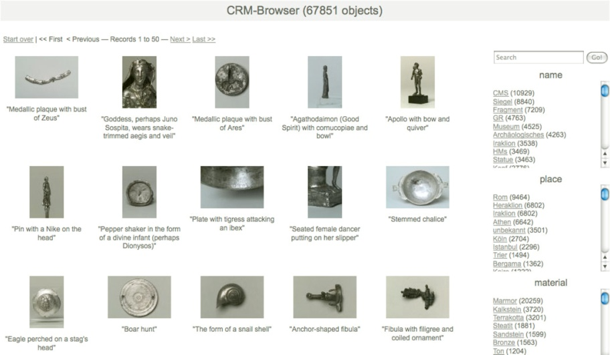
Ideas are a Dime a Dozen
Notes:
21

Slide 22
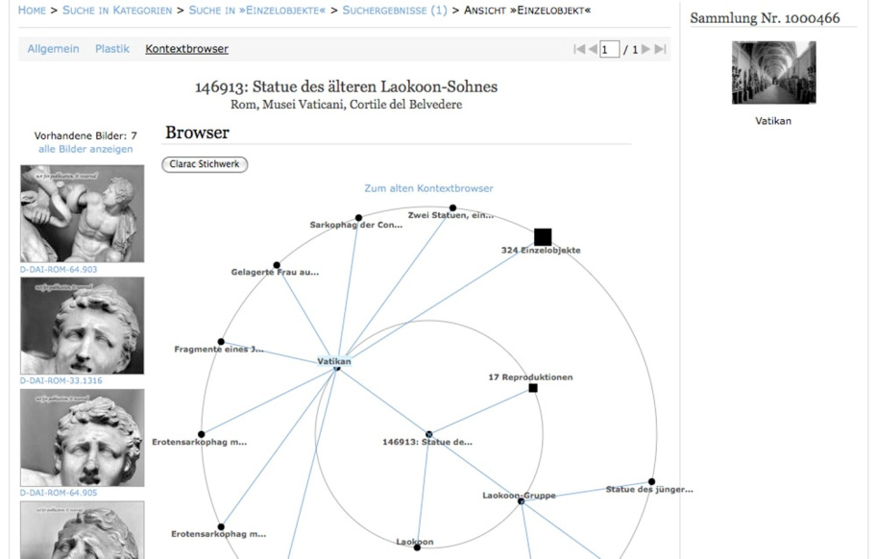
Putting it Into Practice
Exploring contexts within Arachne and beyond.
Purposeful and strategic collaborations.
Texts and objects integrated, Arachne and Perseus.
Notes:
22

Slide 23
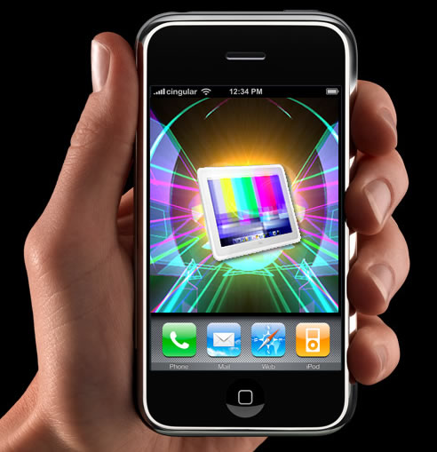
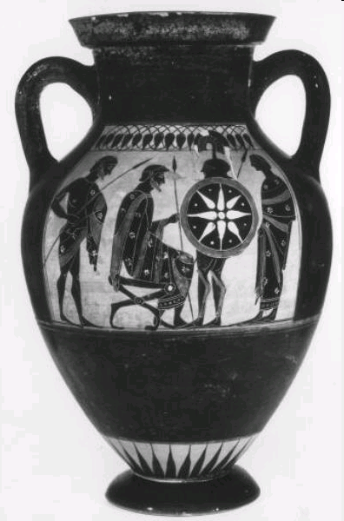
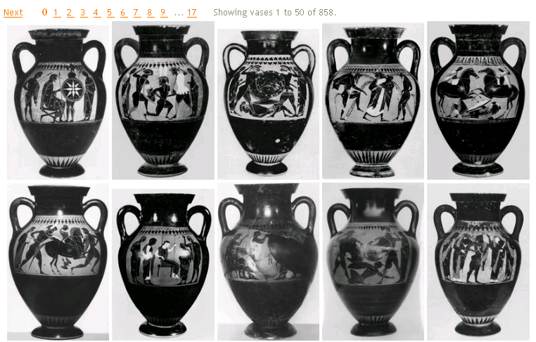
Image Recognition
Visually defined query
it is an amphora
Data
… and here are similar objects in the archive
What is this?
Notes:
[i return]
In the screencasts you saw how shapes of pottery could be recognised.
Since we study objects image recognition has great potential.
This type of technology is very new. When I showed Andrew Zisserman, a world leader in computer vision, the range of objects we study he asked if he could begin with the pottery. It is an ideal place to start because there are so many examples and the shapes are well defined.
The future will be dominated by hand-held devices.
Just as you can use an i[phone now to find a restaurant near your hotel you will be able to use it soon to learn about things you see.
You might see an object on the web or in a museum. You could upload it to your mobile phone.
Without using any words to search your image can be sent to the CLAROS site and you will be shown similar pieces.
23

Slide 24
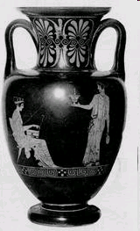
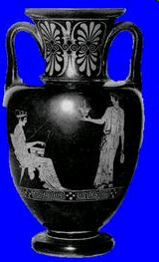
Shape Representation
foreground separation
silhouette representation
original image
vector
X₁
X₂
.
.
.
X_{n}
No representation of patterns or surface markings
100-dimensional “vase shape space”
Notes:
In order to do this the computer needed images.
We gave Andrew Zisserman and his team access to our 130,000 images of pottery.
He needed to create a ‘description’ of the object in each image – in this case, the shape of the vase, not the decoration.
A number of processing steps were then carried out automatically:
first, the vase is separated from the background
second, the mid-line of the vase is computed, and the shape of the silhouette described in terms of its distance from this line
24

Slide 25
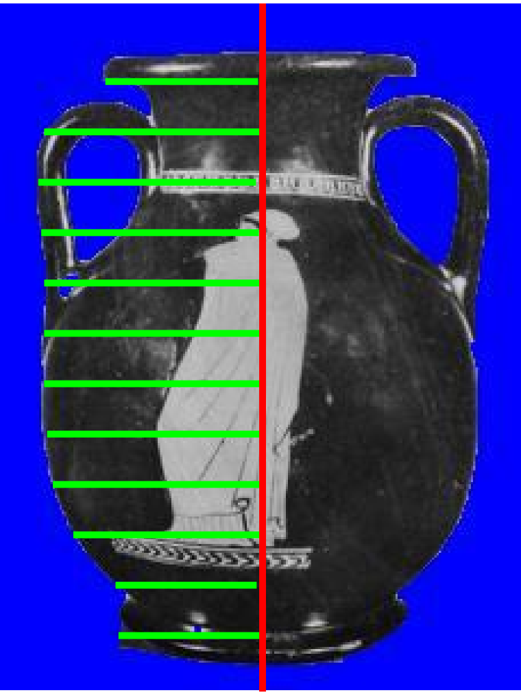
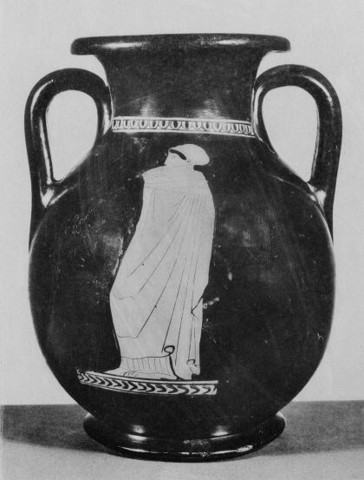
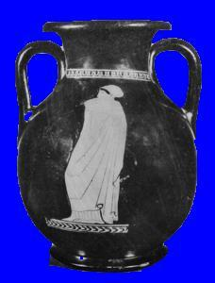
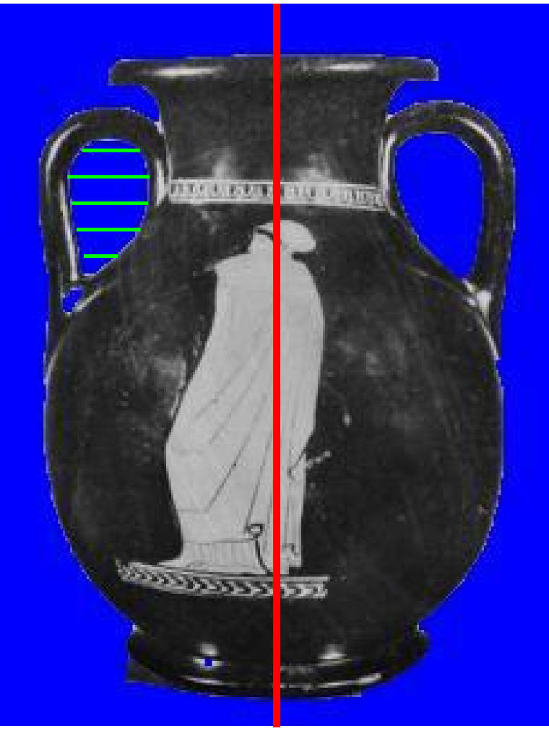
Shape Representation- details
silhouette (both sides)
handles
Notes:
Both the outer silhouette of the vase and the handles are described.
In this way each vase is represented by about 100 numbers, and each vase can then be thought of as a point in a 100 dimensional "vase shape space".
25

Slide 26
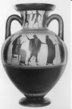
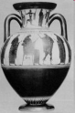
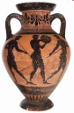
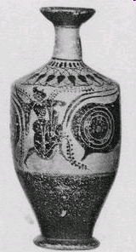
Vase shape space
Notes:
Vases with similar shape will be close together in this space, and those with different shapes further away.
A rounded shape with two handles – for example, the amphora above - is clearly nothing like a more cylindrical shape with one handle hidden from view – a lekythos below.
26

Slide 27
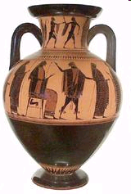
Compute three nearest neighbours for each vase
query
classify shape
all three are amphora neck
“judge me by the company I keep”
“vase shape space”
Notes:
This information can then be used to classify the shape of a new vase : if several of the ‘close neighbours’ all agree on the shape, then we can be confident that it does have that shape.
27

Slide 28
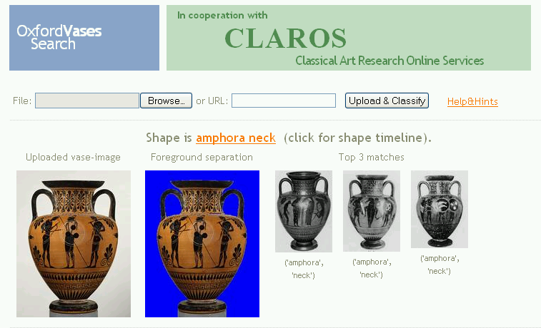
Step by step demonstration:
Step 1: upload image
Notes:
As part of Claros Andrew and his team have provided an on-line service to accept images, initially of vases.
You have already seen this greeting web page, and how a user can upload an image starting from the web or from a photo on his own computer.
28

Slide 29
Step by step demonstration:
Step 2: classify shape
Notes:
This example Andrew uploaded from the web.
The first image is the original upload (the query).
The second shows the separation of the vase foreground from the background - in blue. This separation processing takes a few seconds. The actual search, through 130,000 vase images takes a fraction of a second.
On the right are the images of the three closest vases, and they agree that the shape is 'amphora neck'
Clicking on 'amphora neck' launches the Claros Explorer, as you saw in the demo.
29

Slide 30
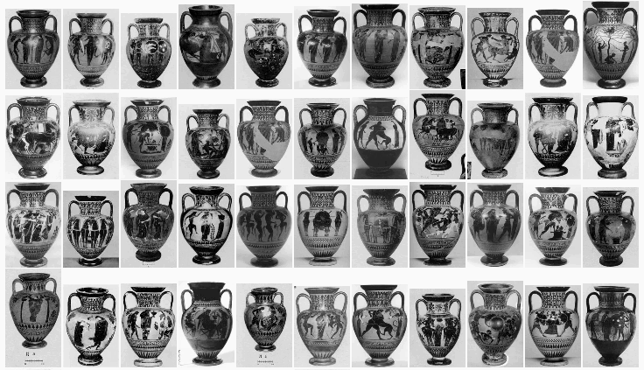
Step by step demonstration:
Step 3: matches in CLAROS
Notes:
And a list of similar vases in CLAROS is also provided, all ordered by similarity in shape to the query vase.
Clicking on ANY of these provides information about ts date, location etc. - taken directly from the Beazley Archive pottery databases. We've illustrated the idea of searching by image with a vase, but we could use the same system for other objects in CLAROS, such as sculpture.
To help Rheinhard with his half million images of classical sculpture Andrew and his team only need to compute a new type of image descriptor. It sounds simple but the technology is new and challenging.
And why are we doing this? After all. I could have told you it was an amphora –neck in a fraction of a second!
We are doing this primarily to broaden access: when there is no text in the search there are no language barriers. Anyone can search this way and also be wholly from the constraints of the terminology that classical archaeologists have generated for centuries.
Looking farther ahead I see the potential for a global registry of antiquities that will engage with the public.
When a traveller, an excavator, a collector or a curator in a museum store sees an object and does not know what it is, he can upload it to CLAROS. An image recognition system can sort the sculpture from the pottery, the gems from the bronzes, and send each type of object to the centre where it is studied – for example, the sculpture to Cologne, the pottery and gems to Oxford. We identify the object, give it a unique record number and upload it to CLAROS where every one can see it.
This will greatly stimulate academic research.
30

Slide 31
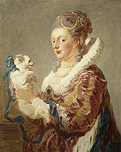
Portrait of a Lady with a Dog, by Fragonard (1769)
Oil on canvas. Metropolitan Museum of Art, Fletcher Fund 1937, accession no. 37.118
The Companions Project
Yorick Wilks
Oxford Internet Institute
Notes:
[here I carry on]
The image recognition system for pottery works now. We hope to implement the sculpture within a year or so.
Another thing we would like to do soon s introduce artificial intelligence.
In Oxford Yorick Wilks, a world expert in artificial intelligence, has been looking at agents or companions to assist learning.
Our subject is intellectually so rich it can seem to be inaccessible to those who have not had a classical education. Yorick and I think a companion could be helpful. Yorick chose the 18th-century painting to express the concept of a companion.
31

Slide 32
The Companions Project
E.U. Framework 6 Integrated Project
Multi-modal Interfaces (2006-2010)
Notes:
He has been taking part in a four-year EU-funded project to develop an ‘agent’ to reside on your computer, and learn about you and your preferences, to help you to access the internet more efficiently and more easily.
The Companion is not a robot and it does not need a specific platform. It can reside in your computer or mobile phone.
It learns about you and your preferences and it retains this information in its memory. That enables it to learn more about you the more you search. It can then automatically – without your intervention - extract information from anywhere on the web that it relevant – whether it is a text record or an image.
In the EU project, which is targeted at Europe’s aging population, it uses common data stores such as Facebook or Wikipedia.
32

Slide 33
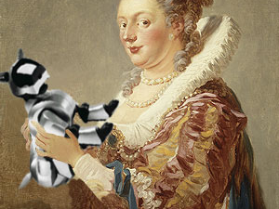
Fragonard and Wilks
Medicean lady with robo-dog
Notes:
Yorick has a sense of humour and he has playfully adapted Fragonard’s painting. The 16th c Medicean court lady is now holding a 21st c robotic dog. In the EU project the companion is an avatar - a small white dog with very large blue eyes and a big brown wig. I thought FIEC needed something more tasteful!
In this short video Yorick shows you how a Classical Companion might look. Remembering Dante in the Divine Comedy, he chose Virgil.
33

Slide 34
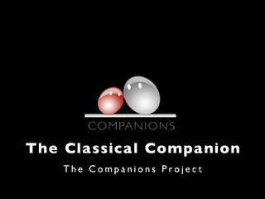

Slide 35
How can this technology advance scholarship?
Artificial Intelligence can build an agent and organize data
Human Language Technology (HLT) can recognize different languages
The Companion can be a visible presence or invisible, providing additional information as text in your own language
Automatic extraction of data from the web can enhance and facilitate research – for example, from Wikipedia and Facebook
Notes:
35
If Virgil has unsettled some of you, I can assure all of you that he has a very serious academic purpose.
A Classical Companion could extract data from anywhere on the web automatically without the user’s intervention. He could accompany a scholar to museums or archaeological sites, but its greatest potential probably lies in making our subject accessible to anyone anywhere.
Since Human Language Technology already enables voice recognition in many languages the Companion could help us to cross language barriers.
If you found an avatar Companion tedious, he/his knowledge base could be transformed into text at the bottom of your screen.
And if Wikipedia and Facebook fill you with horror, please remember that at the outset CLAROS will have more than 2 million classical records and images, and that there are any other scholarly resources on the web, such as TLG, Perseus, etc. from which data could be automatically extracted.

Slide 36
Notes:
In conclusion, if we want our subject to have a future we must, of course, advance scholarship, but we must also make classical antiquity accessible to the public in ways they can understand. In today’s world we must attract people’s interest and must sustain it. Technology can help us to fire the imagination, inspire learning and promote the scholarship of classical antiquity.
36

Slide 37
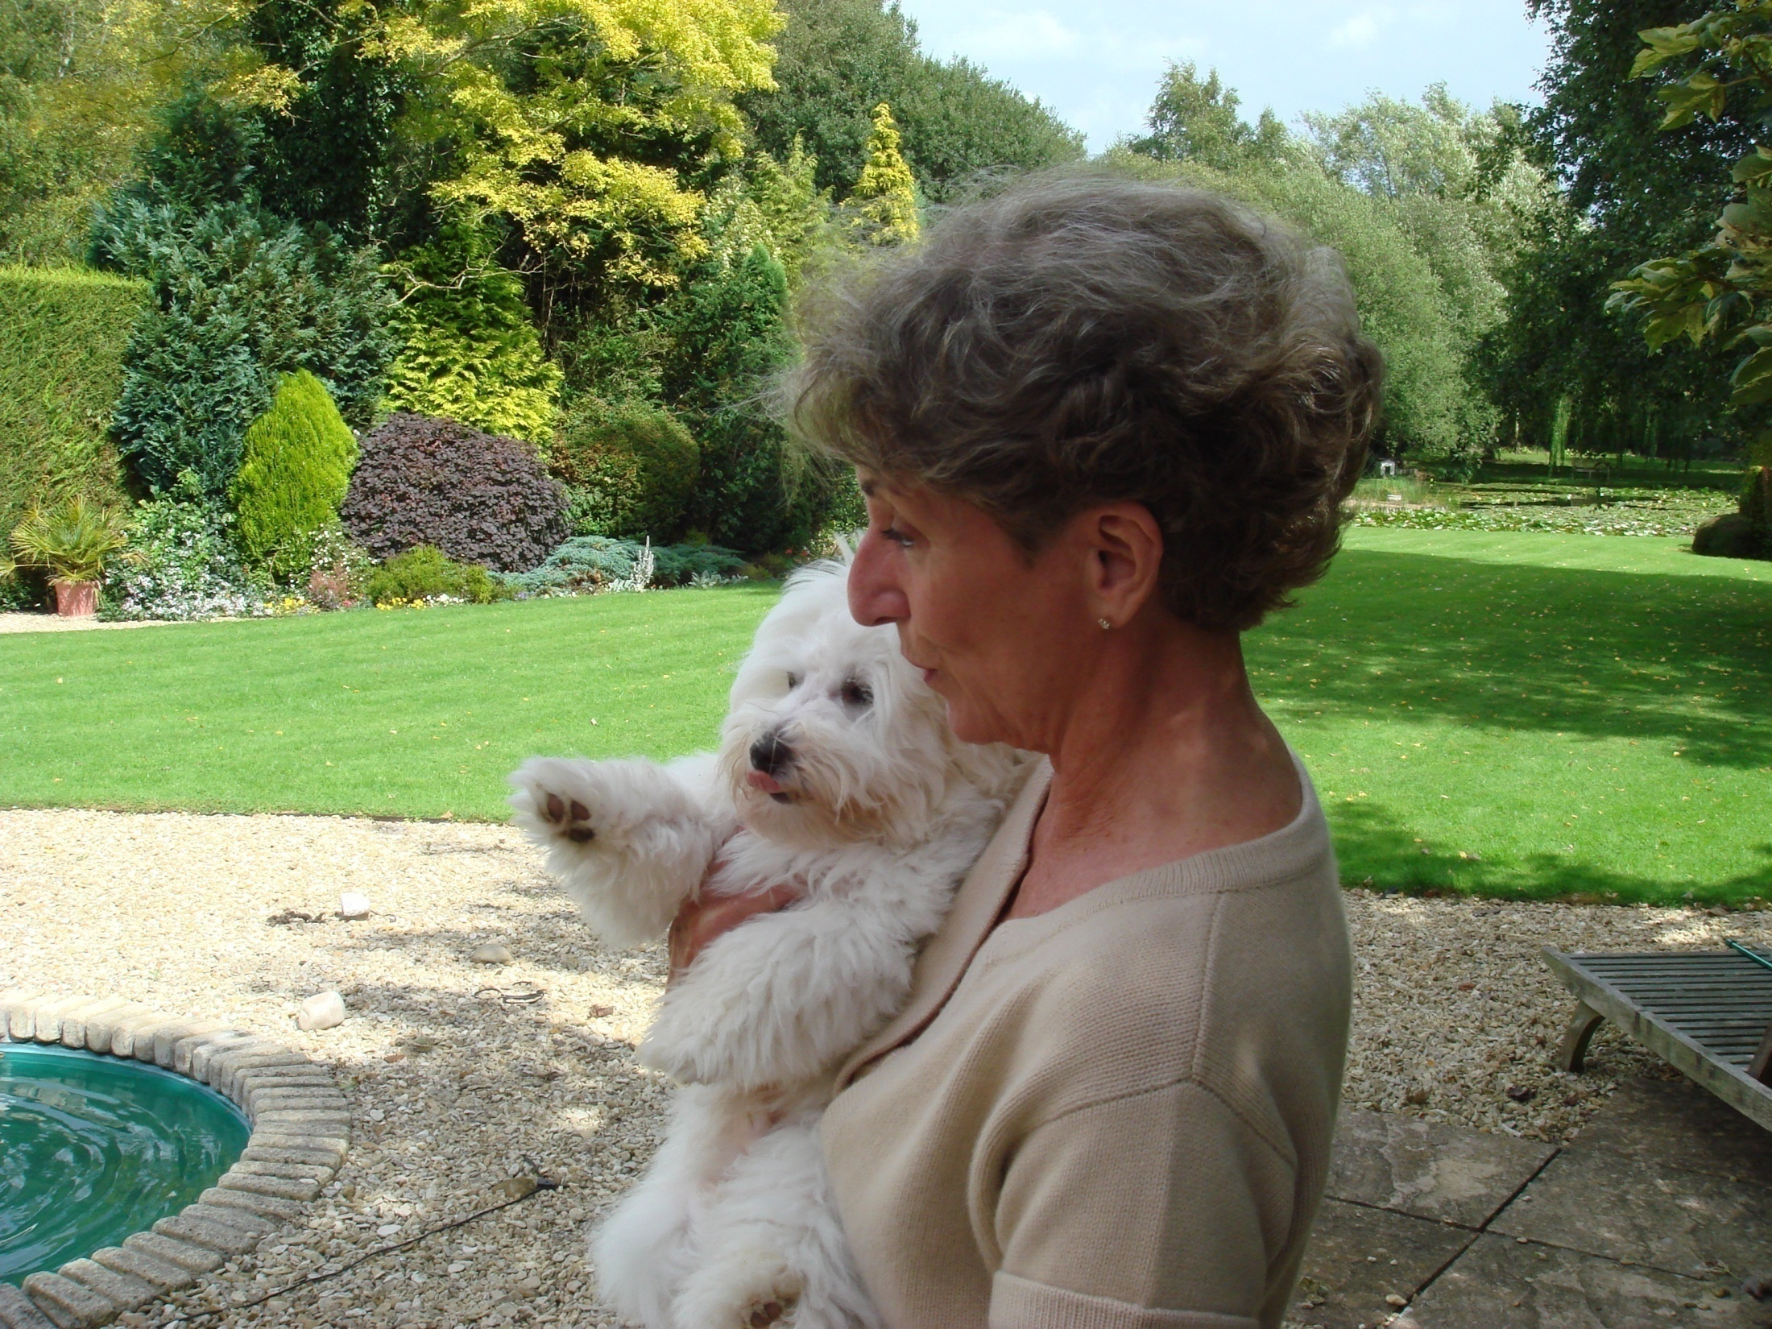
Notes:
Another woman with a white dog would like to thank you for listening.
37

Slide 38
Notes:
38

